Slide 1
Predictive Maintenance of Industrial Machinery The Challenge
CAPSTONE PROJECT
Presented By:
Student Name- Anchal Rajak
Collage Name- SAM Global University Bhopal Madhya Pradesh
Department- Information Technology (MCA)

Slide 2
OUTLINE
Problem Statement
Proposed System/Solution
System Development Approach (Machine Learning)
Algorithm & Deployment
Result (Output Image)
Conclusion
Future Scope
References

Slide 3
Problem Statement
Develop a predictive maintenance model for a fleet of industrial machines to anticipate failures before they occur. This project will involve analyzing sensor data from machinery to identify patterns that precede a failure. The goal is to create a classification model that can predict the type of failure (e.g., tool wear, heat dissipation, power failure) based on real-time operational data. This will enable proactive maintenance, reducing downtime and operational costs.
Objective: Develop a predictive maintenance model to anticipate machine failures.
Challenge: Use sensor data to identify patterns that precede failures.
Target : Failure or Not
Failure Type : Type of Failure
Impact: Reduce downtime and operational costs through proactive maintenance.

Slide 4
Proposed Solution
1. Data Collection:- Gather synthetic sensor data from industrial machines, including: Air temperature, process temperature, rotational speed, torque, tool wea , Product quality indicators (L/M/H), Machine failure labels and failure types, Integrate real-time operational data streams for future scalability.
2. Data Preprocessing:- Clean and preprocess the dataset:- Handle missing values, outliers, and normalize sensor readings. Ensure no data leakage by excluding target labels from feature se, Perform feature engineering.
3. Machine Learning Algorithm:-
- Binary classification: Failure vs. No Failure
- Multi-class classification: Type of failure (tool wear, heat dissipation, etc.)
- Algorithms considered:
- Random Forest, Logistic Regression
- Neural Networks for deeper pattern recognition
- Incorporate domain-specific features like product quality and operational stress indicators
4. Deployment (IBM Cloud Lite Services):- Use IBM Watson Studio for model development and training. Store data using IBM Cloud Object Storage. Deploy model as an API or web app using IBM Code Engine. Ensure scalability, low latency, and secure access for industrial stakeholders
5. Evaluation:- Accuracy, Precision, Recall, F1 Score. Confusion matrix for classification clarity. Perform cross-validation and hyperparameter tuning . Continuously monitor prediction accuracy and retrain with updated data
6. Result:- Achieve reliable prediction of machine failures and their types. Enable proactive maintenance scheduling, reducing unexpected breakdowns. Improve operational efficiency and cost savings for industrial operations. Demonstrate successful integration of ML with IBM Cloud Lite services.

Slide 5
System Approach
The System Approach selection outlines strategy and methodology for developing and implementing the “Predictive Maintenance of Industrial Machinery The Challenge”. Here is suggested structure for this section.
System requirements:-
Use IBM Watson Studio for model development and training.
Store data using IBM Cloud Object Storage.
IBM cloud object storage for dataset handling.
Deploy model as an API or web app using IBM Code Engine.
Ensure scalability, low latency, and secure access for industrial stakeholders.

Slide 6
Algorithm & Deployment
Algorithm Selection:
Random Forest Classifier, Logistic Regression.
tool wear, heat dissipation, power failure.
Failure vs. No Failure and Overstrain Failure
Data Input:
UID: unique identifier ranging from 1 to 10000
Product ID: consisting of a letter L, M, or H for low (50% of all products), medium (30%), and high (20%) as product quality variants and a variant-specific serial number
air temperature [K]: generated using a random walk process later normalized to a standard deviation of 2 K around 300 K
process temperature [K]: generated using a random walk process normalized to a standard deviation of 1 K, added to the air temperature plus 10 K.
rotational speed [rpm]: calculated from power of 2860 W, overlaid with a normally distributed noise
tool wear [min]: The quality variants H/M/L add 5/3/2 minutes of tool wear to the used tool in the process. and a
Training Process:
'machine failure' label that indicates, whether the machine has failed in this particular data point for any of the following failure modes are true.
Prediction Process:
Algorithm makes predictions for Continuous input from live sensors (temperature, vibration, pressure)
Streaming data processed via edge computing or cloud platforms.

Slide 7
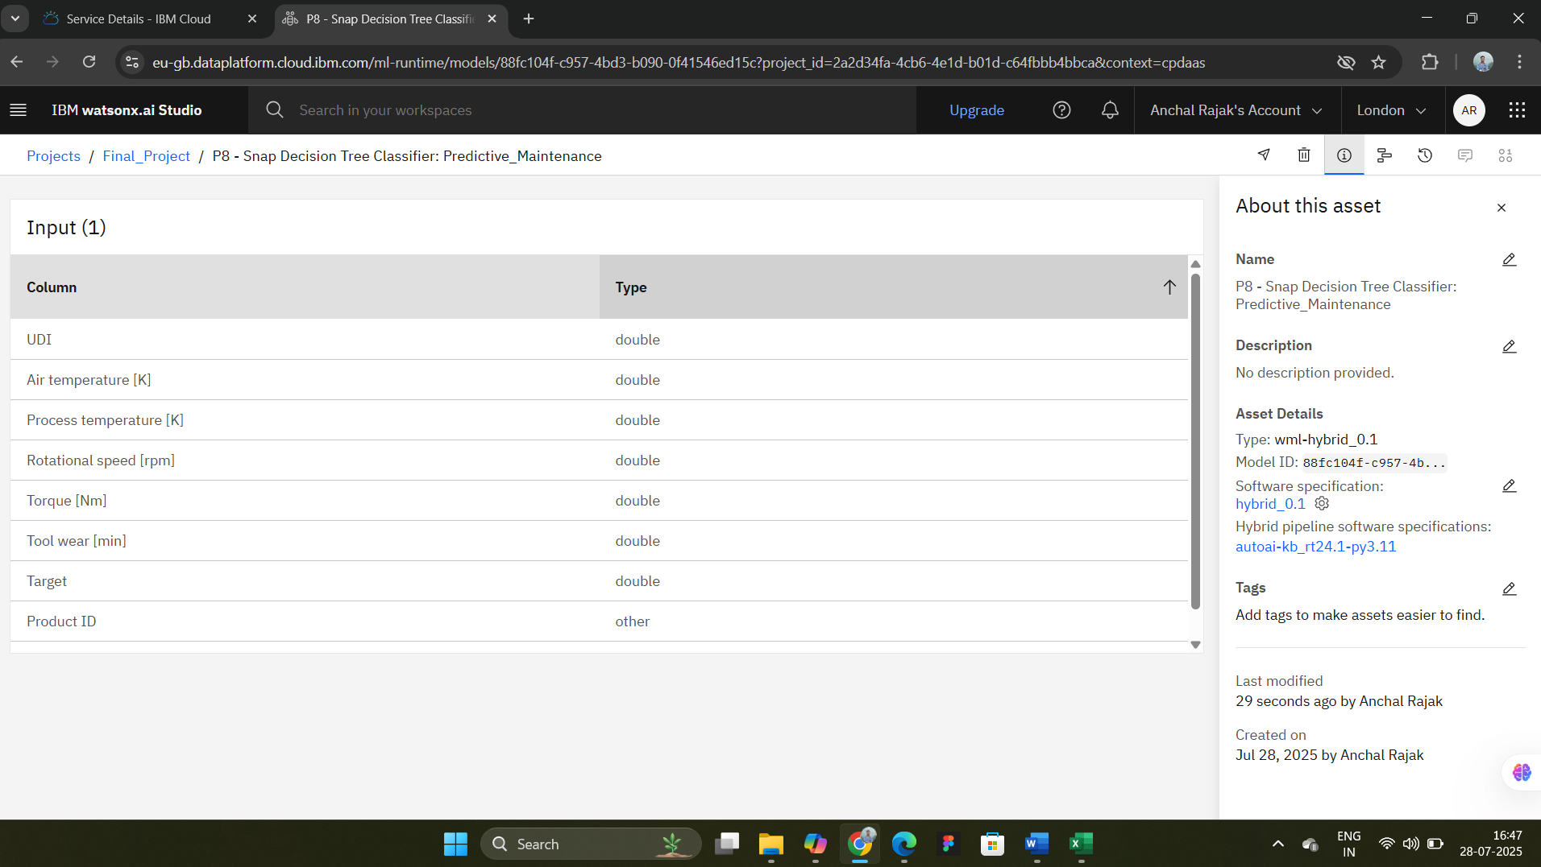
Result

Slide 8
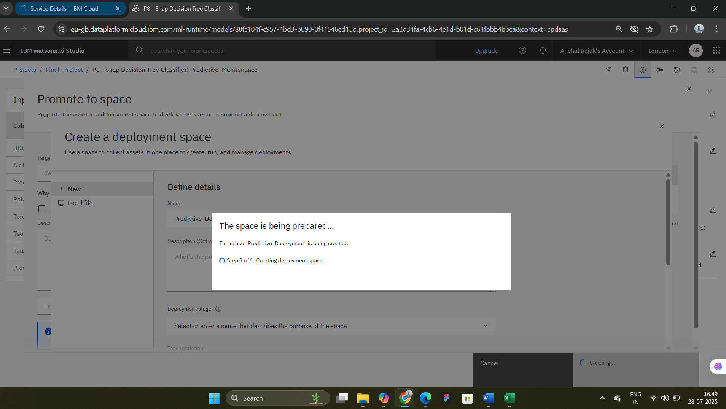
Result

Slide 9
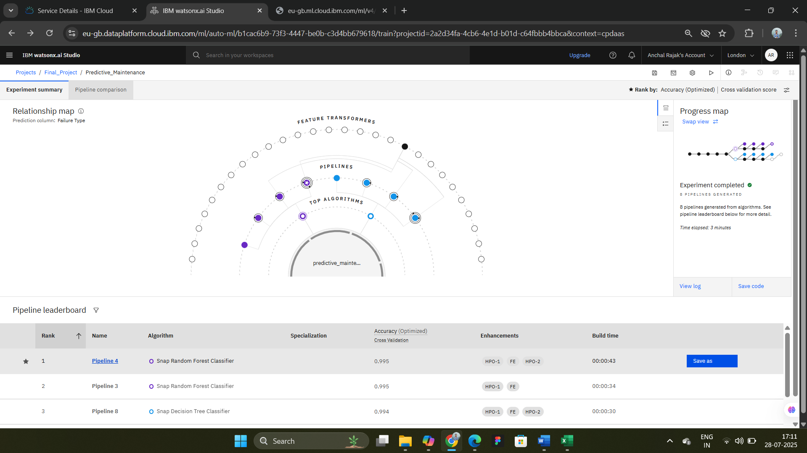
Result

Slide 10
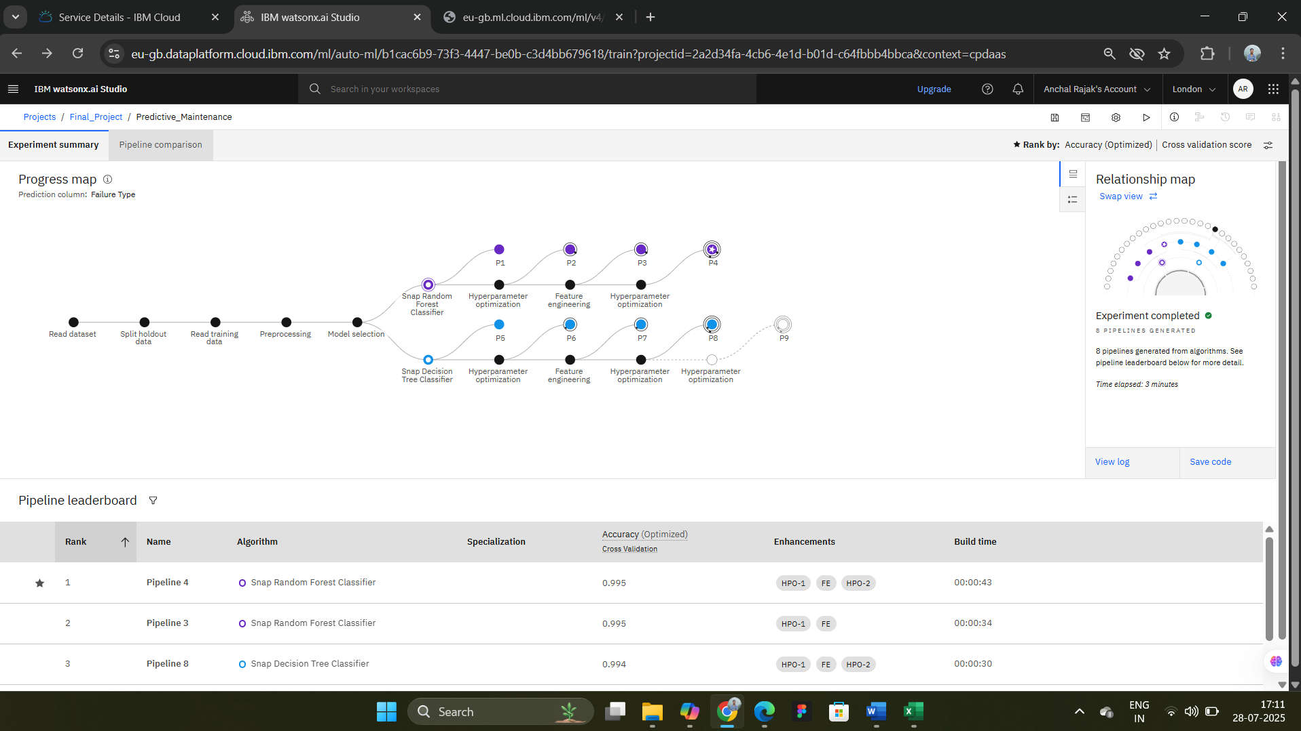
Result

Slide 11
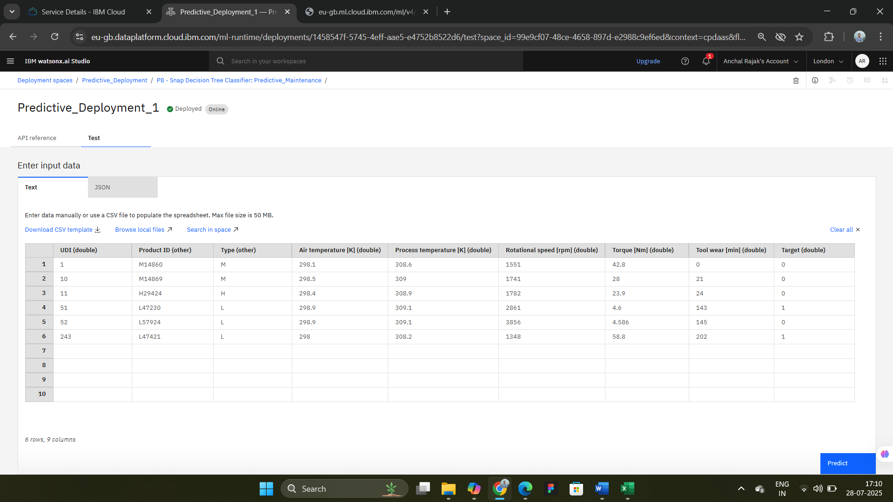
Result

Slide 12
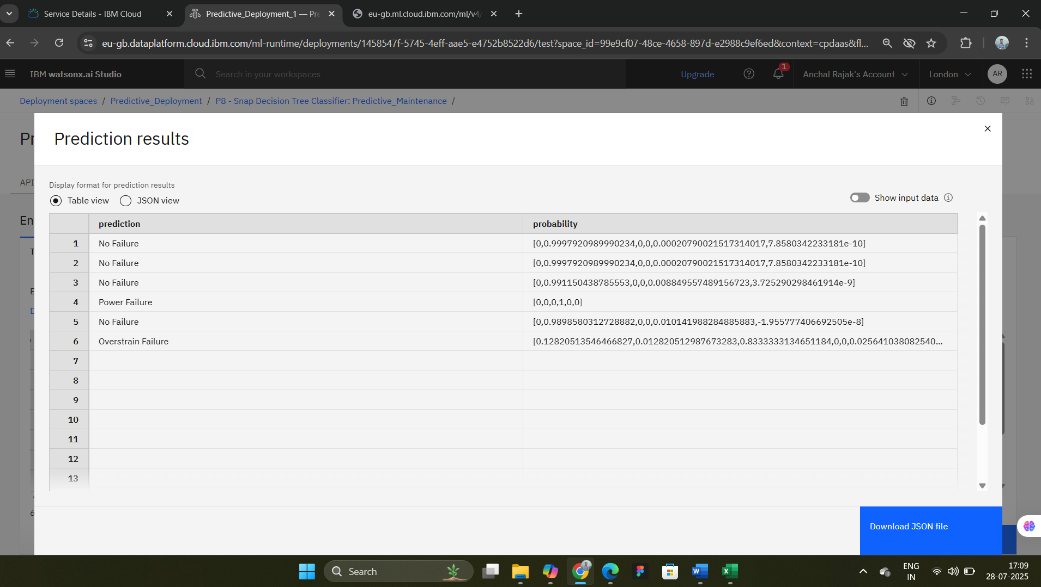
Result

Slide 13
Conclusion
This project demonstrates the power of machine learning in mechanical systems—whether predicting industrial failures or urban mobility trends. The predictive maintenance model enhances equipment longevity, while bike count forecasting supports smart city initiatives.

Slide 14
Future scope
Predictive Maintenance:
Extend to other domains like HVAC systems or automotive diagnostics.
Integrate with IoT platforms for real-time monitoring and alerts.
Bike Demand Forecasting:
Collaborate with municipal bodies for deployment.
Explore reinforcement learning for adaptive bike rebalancing strategies.

Slide 15
References
IBM Cloud Lite Services documentation.
https://cloud.ibm.com/
Email ID:- anchalrajak16@edunetmail.com
Password:- Test@12345678
My Github ID:- https://github.com/anchal-rajak4260?tab=repositories
Kaggle Dataset:- Machine Predictive Maintenance Classification.
Demonstrate successful integration of ML with IBM Cloud Lite services.

Slide 16
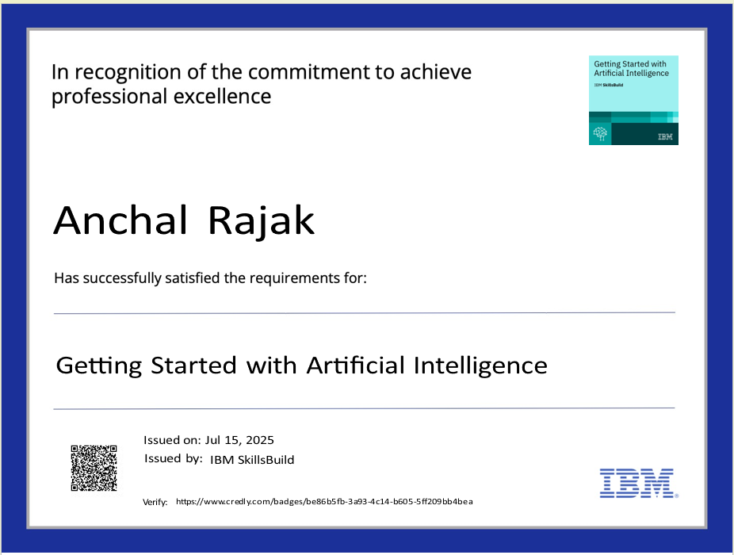
IBM Certifications

Slide 17

IBM Certifications

Slide 18
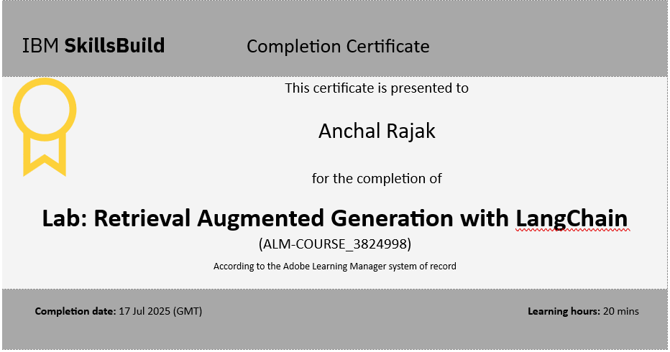
IBM Certifications

Slide 19
THANK YOU

